Slide 1
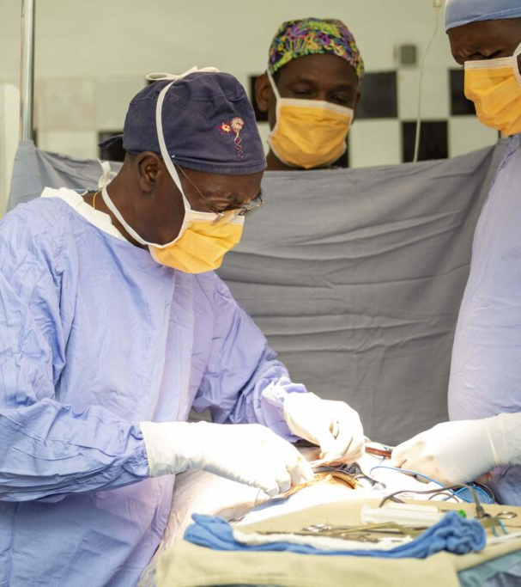
Neurosurgery in Uganda
Inaugural Professorial Lecture
by Prof. Kitya David
Mbchb & MMED Gen-surg (MUK), FCS NEURO-SURG (COSECSA), GSCRT(Epidemi-havard)
MUST - April 16, 2024

Slide 2
History Of Neurosurgery In Uganda

Slide 3
Background
The Lancet Commission on Global Surgery estimates that there are 143 million pending surgical operations globally in low- and middle-income countries (LMIC)
90% of surgical needs occur in the LMICs but only 3% of surgery occurs in these countries.
Within neurosurgery alone, it is estimated that there are over 5-12 million pending operations in LMICs that are not able to be performed due to neurosurgery capacity and availability.
The insufficiency in qualified neurosurgeons constitutes a crucial problem in Uganda

Slide 4
Background
Neurosurgery in Uganda started in the late 1960’s at Mulago Hospital.
By 2000, Uganda still had 4 Neurosurgeons for a population of 30 million, with a ratio of 1: 7.5million people.
Thirteen(13) neurosurgeons for a population of about 47 million people as of July 2021, with a ratio of 1: 3.6 million Ugandans (UBOS).
Currently there are 21 Neurosurgeons with a ratio of 1:2.24 million. The majority of specialist neurosurgeons practice in Kampala.
About 60% of the 21 neurosurgeons are MUST alumnae
The WHO recommendation is 1:100,000 globally, and 1:200,000 in LMICs

Slide 5
Background
Only one public health institution, MRRH, offers neurosurgical services outside the capital city of Uganda, functions with only three neurosurgeons
Cure international children’s hospital (ca. 2000) and Mengo hospital ( ca. 2017) are both nonprofit making privately owned hospitals.
The progress has been very slow over the years and there is no equity for neurosurgical services delivery in this country.
Historically several problems compounded this.

Slide 6
Distribution of surgeons in Uganda
Only four(4)centers offer organized neurosurgical services in Uganda.
More than 95% of the surgeons practicing in Kampala.
Six(6) neurosurgeons outside Buganda

Slide 7
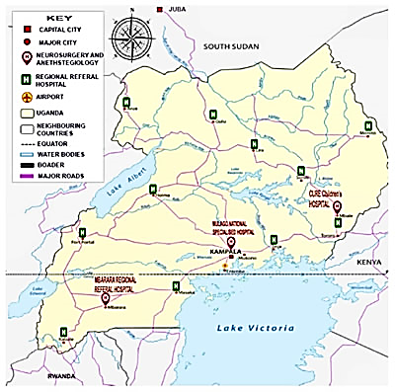
Distribution of Neurosurgeons in Uganda

Slide 8
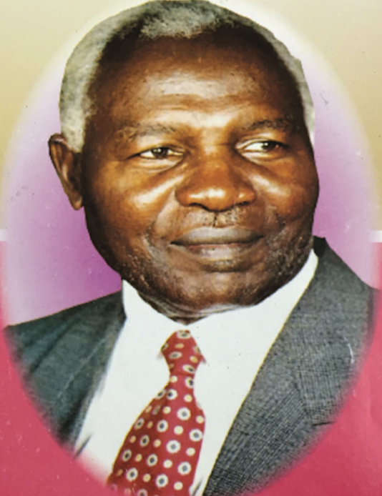
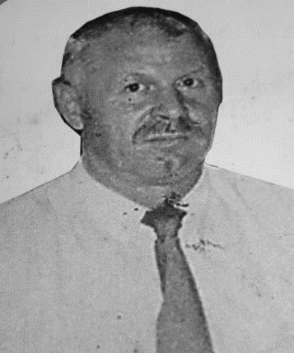
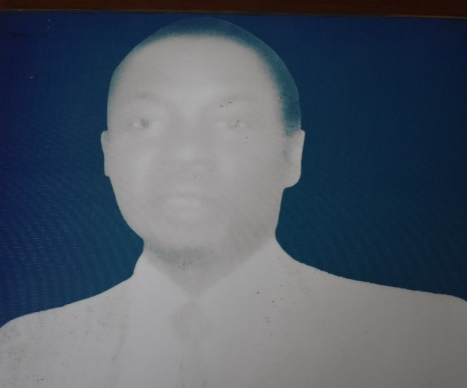
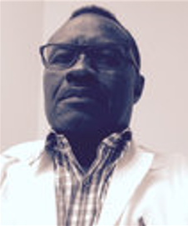
Father of Neurosurgery In Uganda
Prof. Jovan William Kiryabwire - First neurosurgeon in Eastern and Central Africa (1969)
Trailblazers of Neurosurgery in Uganda
Prof Micheal Kahwa
Mbarara Regional Referral Hospital
1983 -1991
Dr. Adupa Dhaffala
Mulago National Referral Hospital;
-1999
Dr. Peter Sherpakov
Mulago National Referral Hospital; 1994-2009

Slide 9
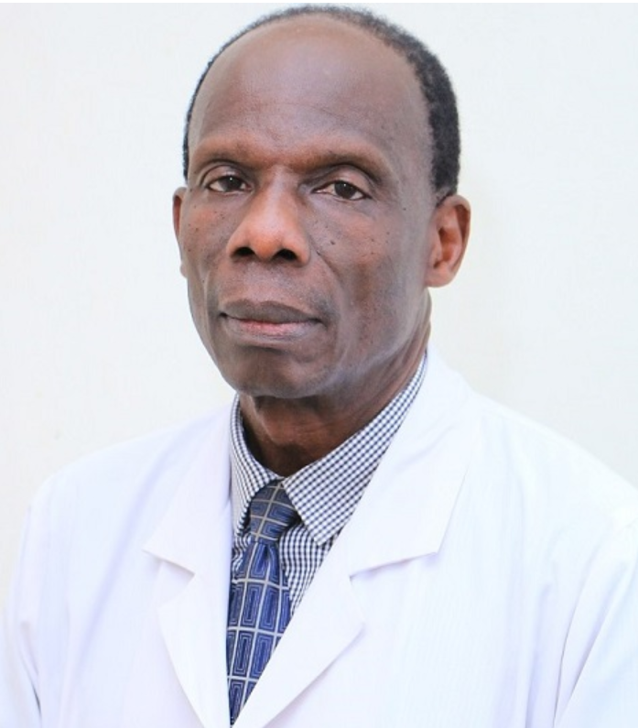
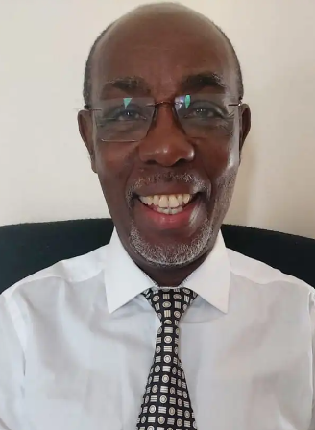
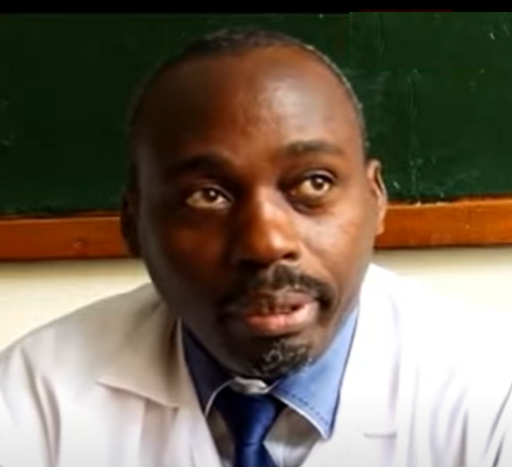
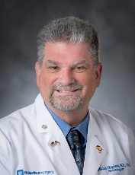
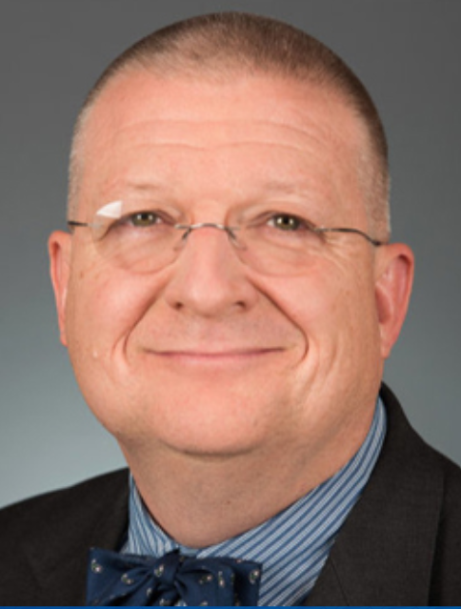
Pioneers of Neurosurgery in Uganda
Prof. David Kitya –Successfully Pioneered Neurosurgery in Regional Referral Hospitals; clinical services, training, research and mobile services (Mbarara RRH; 2012)
Dr. John Mugamba – First Ugandan Paediatric Neurosurgeon (CURE Hospital, Mbale; 2005)
Dr. Michael Muhumuza – Pioneered the First Neurosurgery Training Program in Uganda (Mulago NRH; 2007)
Patrons of Neurosurgery in Uganda
Prof. Michael Haglund – Established the Duke University – Mulago (2007)/Mbarara (2016) Neurosurgery Collaboration; Current Patron of NSU and supports training and research
Prof. Benjamin Warf – Founded CURE Children’s Hospital, Mbale in collaboration with CURE International; 2000
Supported training

Slide 10
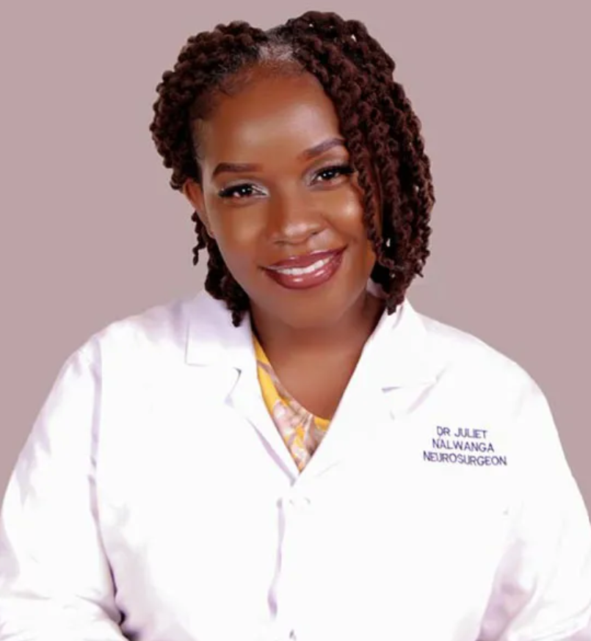
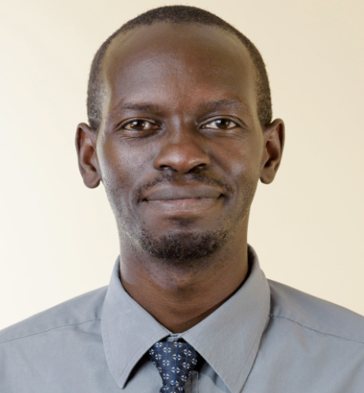
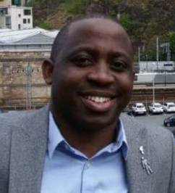
First Neurosurgeons to train in Uganda
Dr. Juliet Nalwanga Ssekabunga
FCS-ECSA (Neuro) 2017
(The first female neurosurgeon in Uganda)
Dr. Obiga Oscar
FCS-ECSA (Neuro) 2015
Dr. Muhindo Alex
FCS-ECSA (Neuro) 2014

Slide 11
Historical Challenges during the Development Neurosurgery
Lack of modern diagnostic services like CT scans, MRI equipment.
Lack of modern equipment to conduct highly complex neurosurgical operations.
Inadequate availability and administration of emergency and critical care services, ICU
Lack of human resource and training facilities; there was only one neurosurgical unit in the country by 2000.

Slide 12
Historical Challenges during the Development Neurosurgery
Limited financing and planning.
Almost no collaborations.
Limited support from the key sister disciplines (anesthesia, radiology rehabilitation and physiotherapy, adjuvant(chemoradiotherapy) and pathology).
Lack of adequate research capacity and drive.
Convincing the community about the demand of neurosurgery services
NO EQUITY OF NEUROSURGICAL SERVICE DELIVERY in Uganda

Slide 13
Development of Neurosurgery in Uganda
Year | Event
1969 | Dr. Jovan Kiryabwire establishes the neurosurgery unit at Mulago National Referral Hospital.
2000 | Dr. Benjamin Warf in collaboration with CURE International (a Christian medical mission organization) founded the CURE Children’s Hospital of Uganda (CCHU). CURE Uganda is now one of the leading pediatric hospitals providing neurosurgical care to children in Africa. 1,900+ cases are done per year
2004 | Dr. John Mugamba joined the staff at CCHU as a fellow in pediatric neurosurgery sponsored by the Foundation for International Education in Neurosurgery (FIENS). In 2005, he took a permanent position as the second pediatric neurosurgeon at CCHU, ultimately becoming its Medical Director for many years.
2007 | Dr. Michael Haglund from Duke University visited Mulago Hospital and initiated a collaboration with Ugandan Neurosurgeons. The Duke-Mulago Program was born. The first Duke Neurosurgery camp was held at Mulago Hospital.

Slide 14
Development of Neurosurgery in Uganda
2007 - 2009 | The initial East Africa Neurosurgical Training Program was developed through the tireless work of neurosurgeons Paul Young, Merwyn Bagan, Moody Qureshi, and Michael Muhumuza. This was to address the critical shortage of neurosurgeons in the region.
2009 | Dr. Muhumuza and Professor Haglund were appointed co-directors of the Ugandan East Africa Neurosurgery Training Program. The first 2 residents were recruited into the program in Uganda.
2012 | Prof. David Kitya established the neurosurgery unit at Mbarara Regional Referral Hospital (following COSECSA Neurosurgery Fellowship training at Kenyatta National Hospital and Ege University, Turkey)

Slide 15
Development of Neurosurgery in Uganda
2014 | The first Ugandan-trained neurosurgeon, Dr. Alex Muhindo, graduated through the COSECSA Neurosurgery Fellowship program at Mulago Hospital.
2016 | The division of neurosurgery Mbarara Regional Referral Hospital started outreach services including the mobile services at Ruharo Mission Hospital in south western Uganda. Held the first Duke neurosurgery camp at Mbarara Regional Referral Hospital.
2017 | The Division of neurosurgery at Mbarara Regional Referral Hospital in collaboration with Duke Global Neurosurgery and Neurology and the division of neurosurgery at Mulago Hospital, established Neurosurgery services at Mengo Hospital and conducted a neurosurgery camp there.

Slide 16
Development of Neurosurgery in Uganda
2017 | The first female Ugandan-trained neurosurgeon, Dr. Juliet Nalwanga Ssekabunga, graduated through the COSECSA Neurosurgery Fellowship program at Mulago Hospital.
2017 | The Neurosurgical Society of Uganda (NSU), a non-profit organization of neurosurgeons, was founded. It is dedicated to providing quality Neurosurgery through a broad spectrum of medical/surgical services to Ugandans and international patients.
2022 | Creation by the MOH of two posts of Neurosurgeons at RRH in Uganda
2024 | The first international neurosurgery skull base course was held in Mbarara University in collaboration with Colorado University, USA. It was organized by Prof. Kitya David and Dr. Taremwa Blessing.

Slide 17
Current State Of Neurosurgery In Uganda

Slide 18
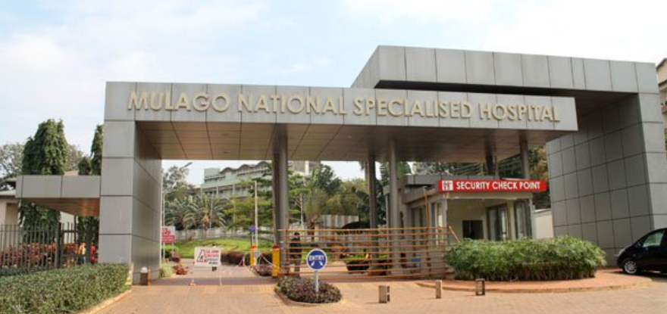
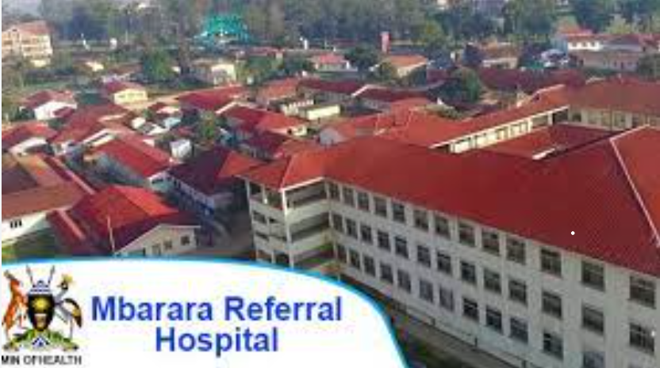
Neurosurgical Centres in Uganda
Public Facilities
Mulago National Specialized Hospital
Mbarara Regional Referral Hospital

Slide 19
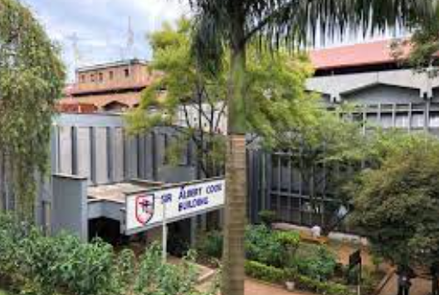
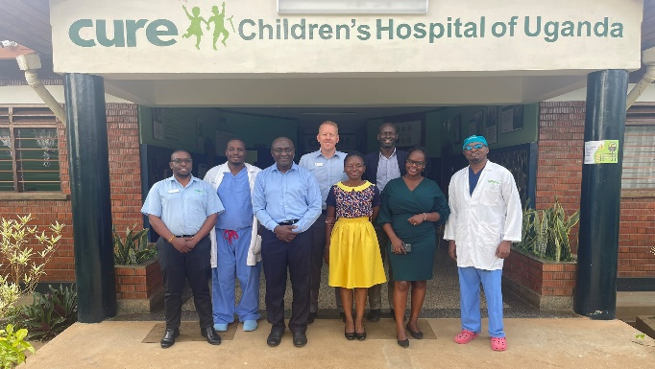
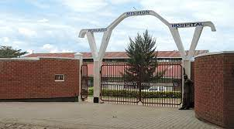
Private-Not-For-Profit (PNFP) Facilities
Cure Children’s Hospital of Uganda, Mbale
Mengo Hospital
Ruharo Mission Hospital, Mbarara
The sites where organized neurosurgery services can be offered in the country have increased from 1 to 5

Slide 20
The Volume
Cure Children’s hospital, Mbale performs about 1900 operations per year.
Records at Mbarara Regional Referral Hospital show an increasing demand for neurosurgery services.
In Mulago Hospital, the numbers are staggeringly high.
In the two public hospitals, the numbers are dominated by head injury admissions arising from road traffic crashes.
Dedicated theatre space at Mbarara Regional Referral Hospital and Mulago Hospital.

Slide 21
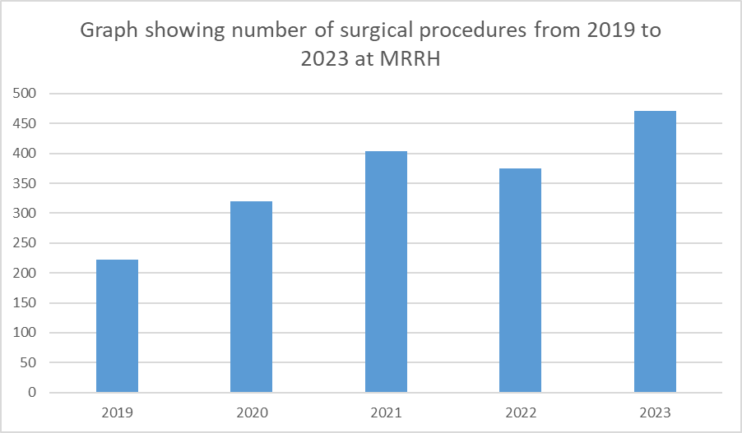

Slide 22
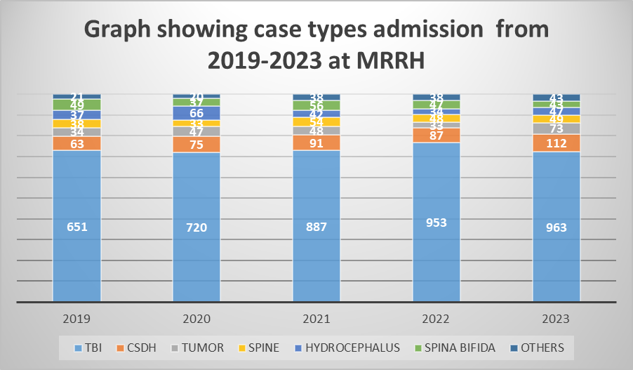

Slide 23
Some of the Neurosurgical Conditions We Treat
Head and spine injuries (Trauma)
Brain and spinal tumors
Vascular malformations in the brain and spine (Aneurysms, etc)
Complicated infections in the brain and spine (Abscesses)

Slide 24
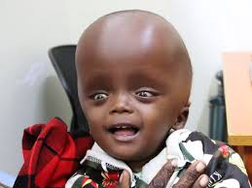
Continuation
Peripheral nerve diseases requiring surgery.
Epilepsy and movement disorders.
Degenerative diseases of the Spine.
Congenital problems and hydrocephalus etc.

Slide 25
Other core stake holders in service delivery present
Radiology
Anesthesia and ICU
Histopathology
Physiotherapy
Nursing
Emergency medicine
Neurology
Oncology
There are organized services and training in each of the above at the moment but no specialist neurologists.

Slide 26
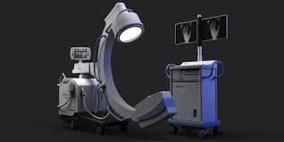
C-ARM

Slide 27
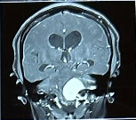

Skull Base surgery

Slide 28
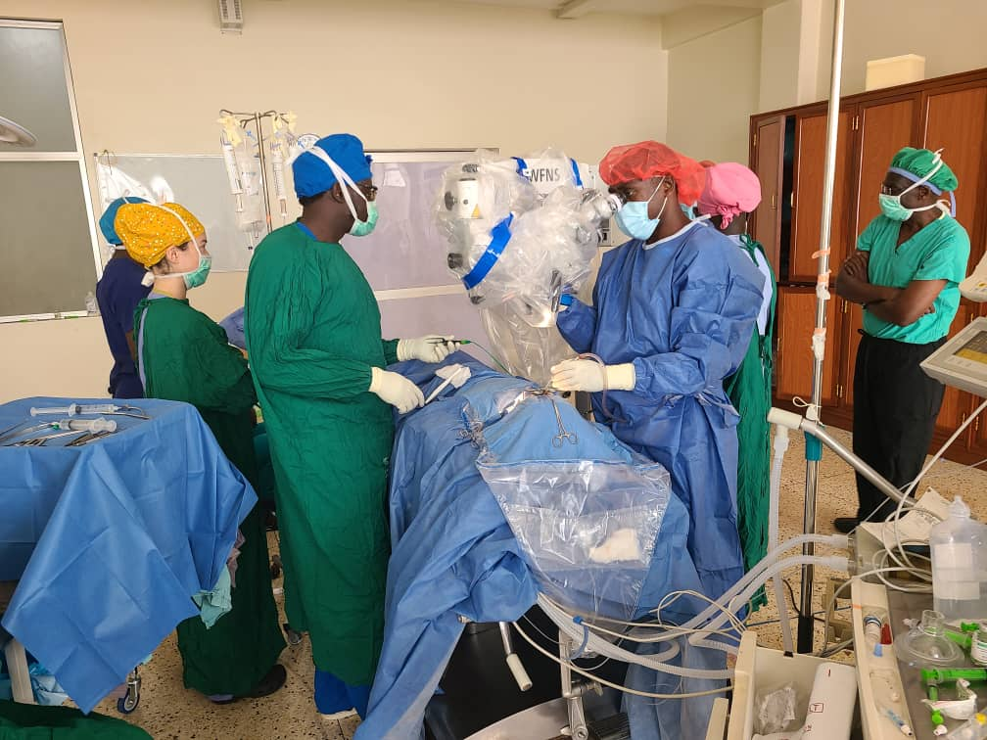
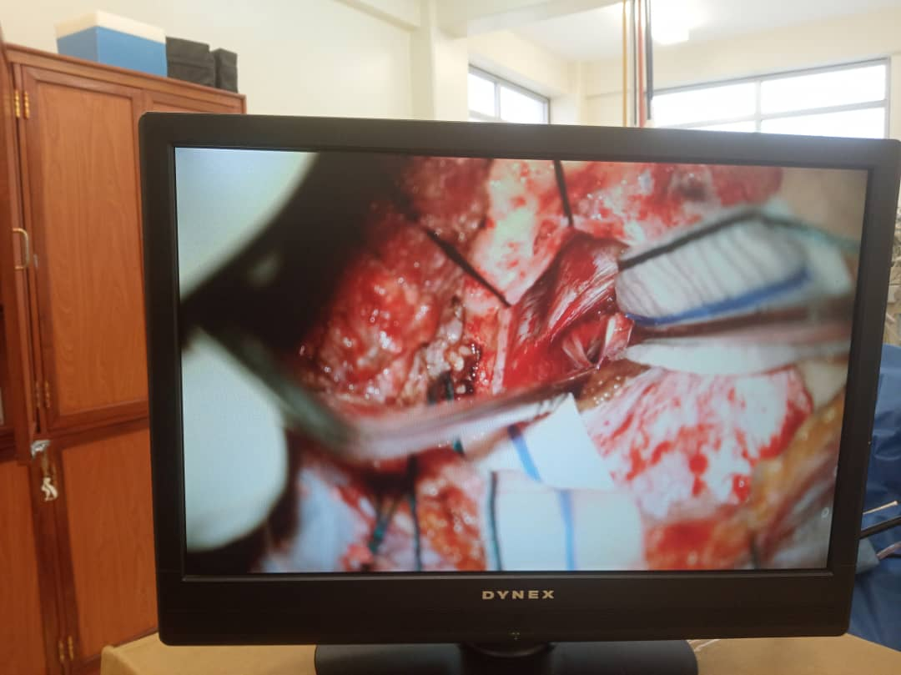
Skull Base surgery

Slide 29

Diagnostic Services
Diagnostic services have markedly improved.
The first CT-Scanner in Kampala,1994, at Mbarara RRH in 2014 and at all regional referral hospitals in 2023.
We now have a MRI scan at MRRH
We have histopathology services and other efficient laboratory services in the two public centers.

Slide 30
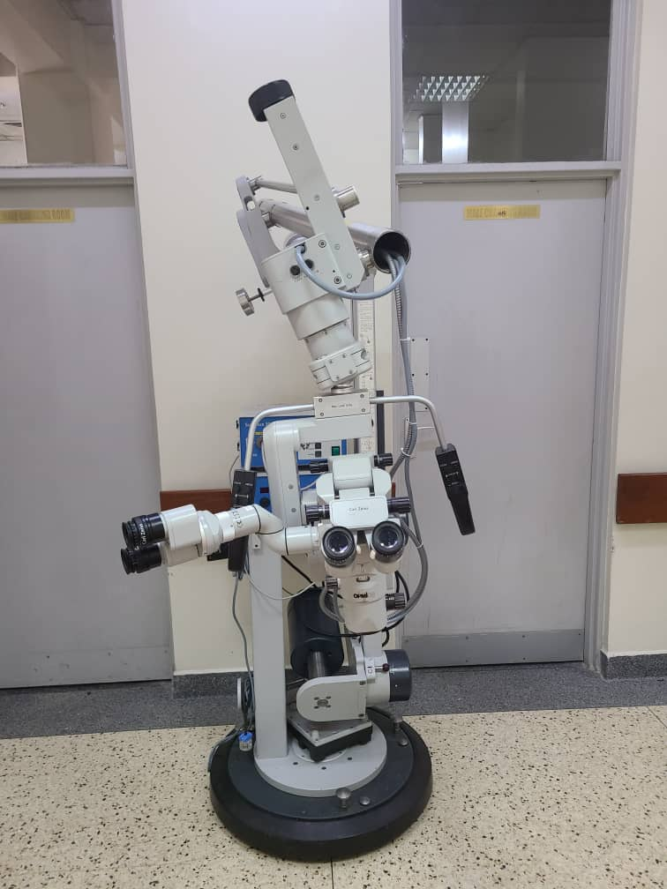
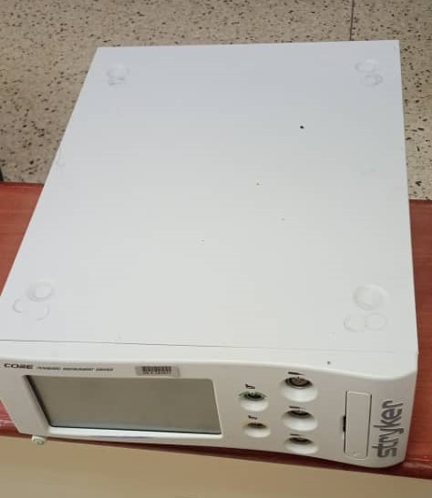
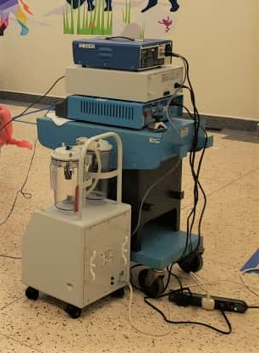
Non-diagnostic Equipment

Slide 31
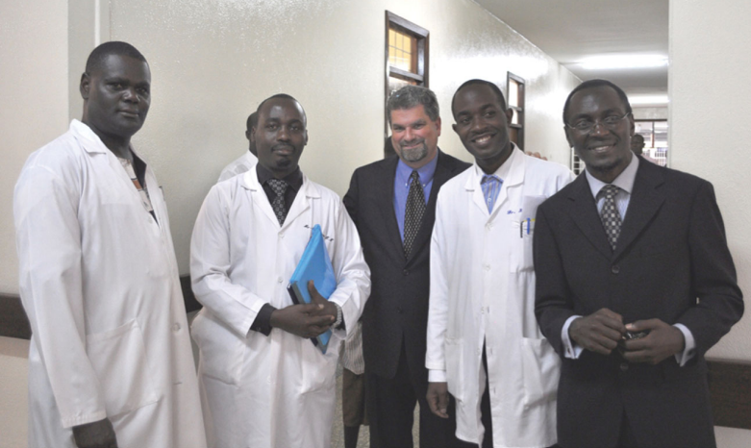
Neurosurgery Training in Uganda
Original Faculty for the Uganda Neurosurgery Training Program
From left to right: John Mukasa, MD (RIP); Michael Muhumuza, MD (co-director); Michael Haglund, MD, PhD (co-director); Hussein Ssenyonjo, MD; Joel Kiryabwire, MD

Slide 32
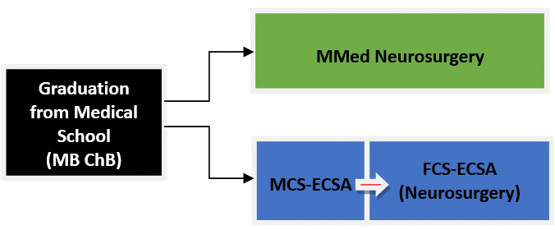
Landscape for neurosurgery training in Uganda
Mmed General Surgery
FCS-ECSA (Neurosurgery) Mmed-Neurosurgery

Slide 33
Products
Number of Graduates: 10, since 2009 in Uganda
Current Number of Trainees:
9 in Mulago National Specialized Hospital
5 in Mbarara RRH

Slide 34

Research and Innovation
Research and innovation are very important in the development of disciplines and medical services.
Records show that research and publications from Africa, between 2010 and 2014 was below 0.5% of the global publications, none in Pediatric trauma.
There has been active participation in research activities currently.

Slide 35
Continuation
Levels
Institutional
Individual
Collaborative (DGNN and Cure Children’s Hospital).
Research involves the whole spectrum of neurology but different areas of interest at different sites.
MRRH (Trauma, Aflatoxins and Pead surgery)
CICH (Pead surg, neuro tube defects and Hydrocephalus)
MNRH (Trauma)

Slide 36
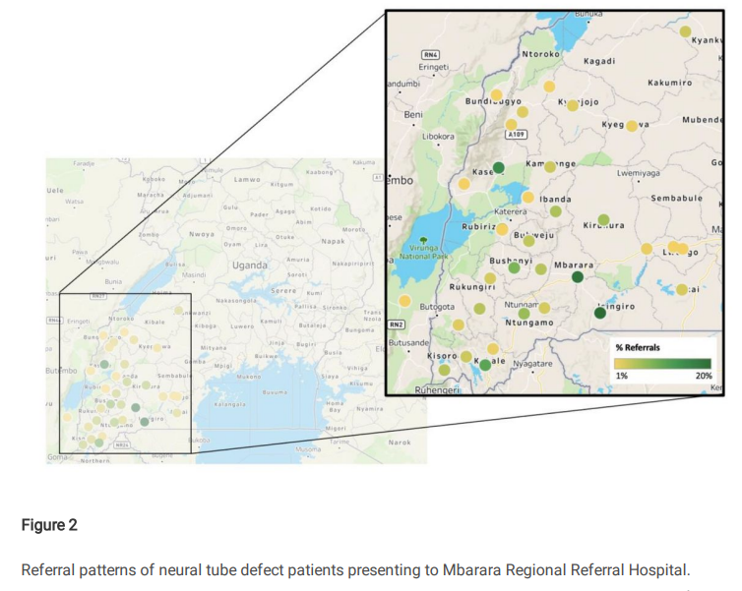

Slide 37
Landmark research and publications
Improving Infant Hydrocephalus Outcomes in Uganda: A Longitudinal Prospective Study Protocol for Predicting Developmental Outcomes and Identifying Patients at Risk for Early Treatment Failure after ETV/CPC (Taylor A Vadset, Joshua Magombe) Cure Children’s Hospital
Endoscopic third ventriculostomy in the treatment of childhood hydrocephalus in Uganda: report of a scoring system that predicts success (Benjamin C Warf, John Mugamba, Abhaya V Kulkarni) Cure Children’s Hospital

Slide 38
Landmark research and publications
3. Paenibacillus spp infection among infants with postinfectious hydrocephalus in Uganda: an observational case control study (sarah U Morton, Smith Jasmine et al) Cure Children’s Hospital and Mbarara RR Hospital
4. Assessment of neuro tube defects among newborns in Uganda: A study of prevalence, risk factors and the role of gene environmental interactions.(Dr David Kitya, Dr Godfrey Bbosa of Makerere University) Mbarara RR Hospital.

Slide 39

Innovations
Innovations of service delivery
Creation of satellite centers for outreach clinics (Cure Children's Hospital)
Outreach services including mobile services (Mbarara Regional Referral Hospital)
Opening up of new centers like Mengo Hospital and Ruharo Mission Hospital. (Mbarara Regional Referral Hospital, Makerere Hospital and DGNN).
Mobile clinics

Slide 40
Innovation in Training
Creation of satellite centers (COSECSA).
Creation of parallel programs(COSECSA and MMED).
Video conferencing (Cure Children's Hospital) with participation of several Sub-Saharan neurosurgery centers including MRRH.
Online and physical Participation in International educational programs (University of Colorado school of medicine, and Cambridge Global Health)
Self autonomous supervision and assessment tool (Division of neurosurgery Mbarara Regional Referral Hospital)

Slide 41

Other Innovations
Collaborative research involving multiple centers and grant writing.
Establishing a professional society (Neurosurgical Society of Uganda(NSU), gives a legal framework to operate.
Memberships; East African Association of Neurological Surgeons(EAANS),Continental Association of African Neurosurgical Societies (CAANS) and FIENS.

Slide 42

Challenges
Limited space, only two public hospitals offering neurosurgery services in the country.
Acute shortages of trained personnel to run the services.
Challenges of co-operation with some stake holders.
Limited subspecialized services within neurosurgery.
Limited supplies
Inadequate service delivery, No Equity
Convincing the community about the demand of neurosurgery services

Slide 43
FUTURE OF NEUROSURGERY IN UGANDA

Slide 44
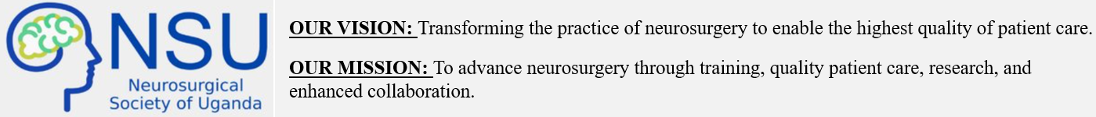

Slide 45
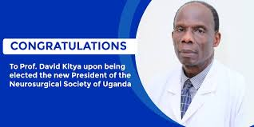
Leadership of the NSU

Slide 46
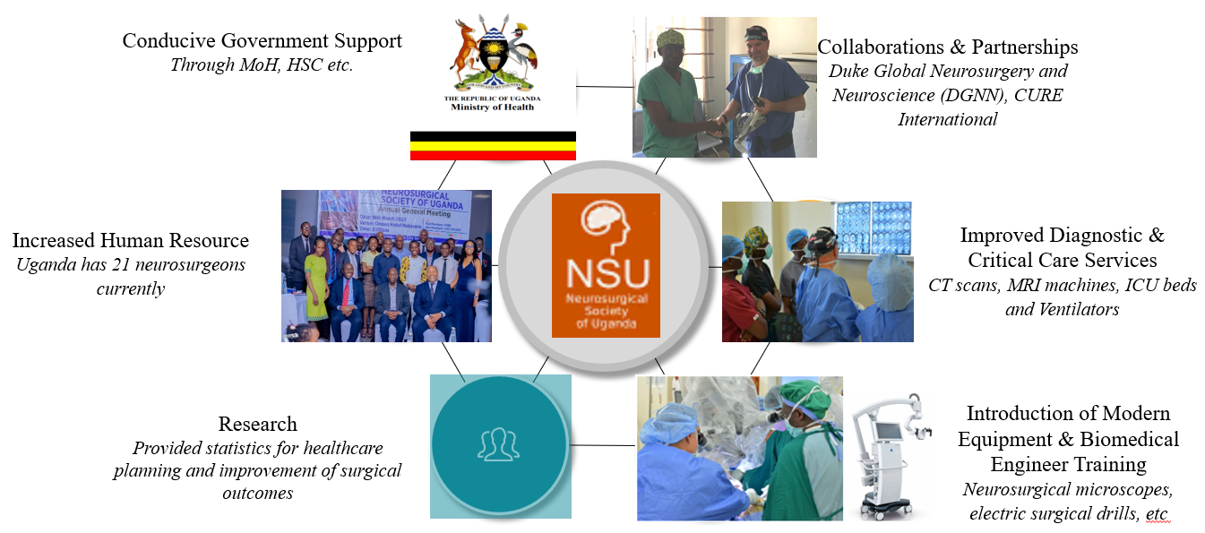
Safe anesthesia and rehabilitation services and chemo-radiotherapy
NEUROSURGICAL SOCIETY OF UGANDA

Slide 47
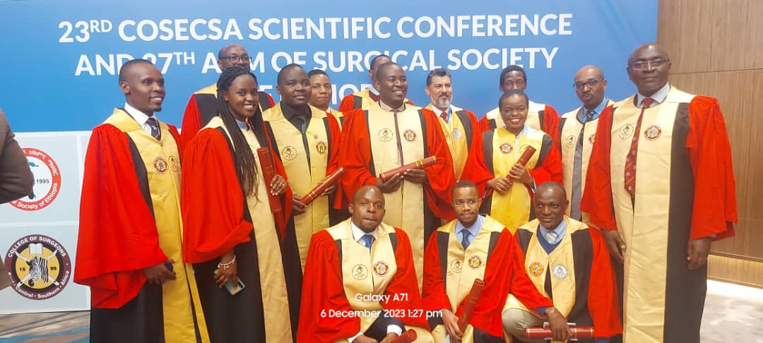
Expanding Training
Strengthening and expanding the COSECSA and MMed Neurosurgery Training Programs
2023 COSECSA graduation and scientific conference

Slide 48
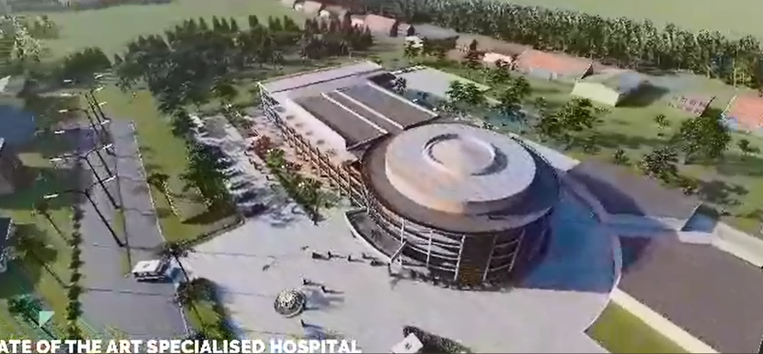
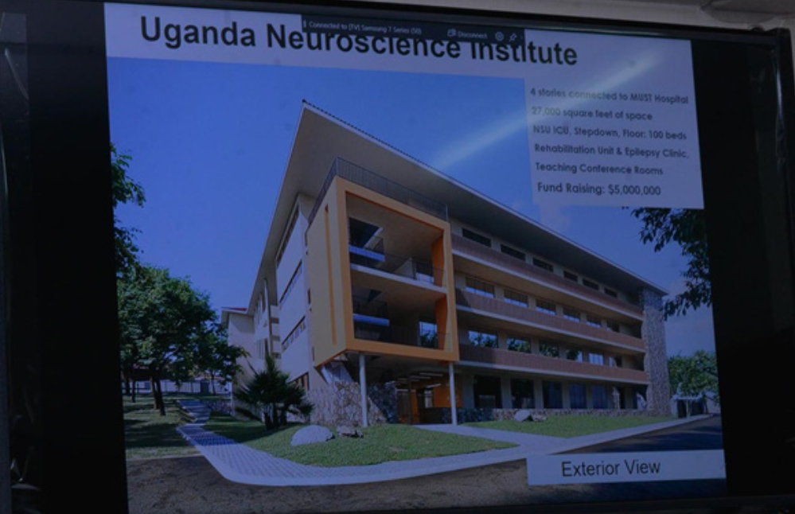
Increasing Neurosurgical Service Centres and Strengthening Services
Establishing Neurosurgery Units in other Regional Referral Hospitals
Building Neurosurgical Centres of Excellence
Creating Subspecialized Neurosurgical Units & Establishing Multidisciplinary Teams
Architectural design of the planned Neurosurgical Society of Uganda (NSU) hospital in Kampala
Architectural design of the planned Uganda Neurosciences Institute (UNI) in Mbarara

Slide 49
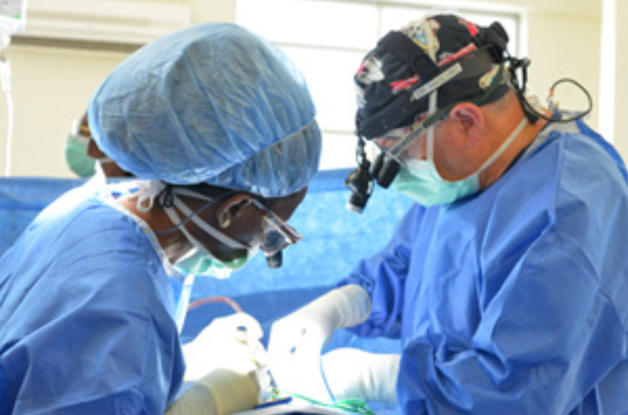

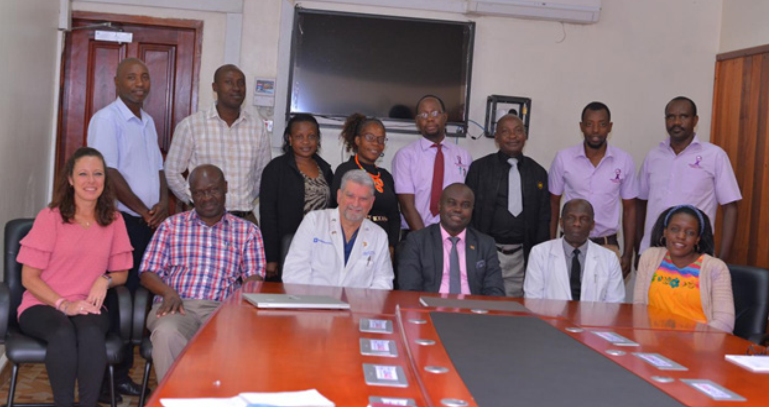
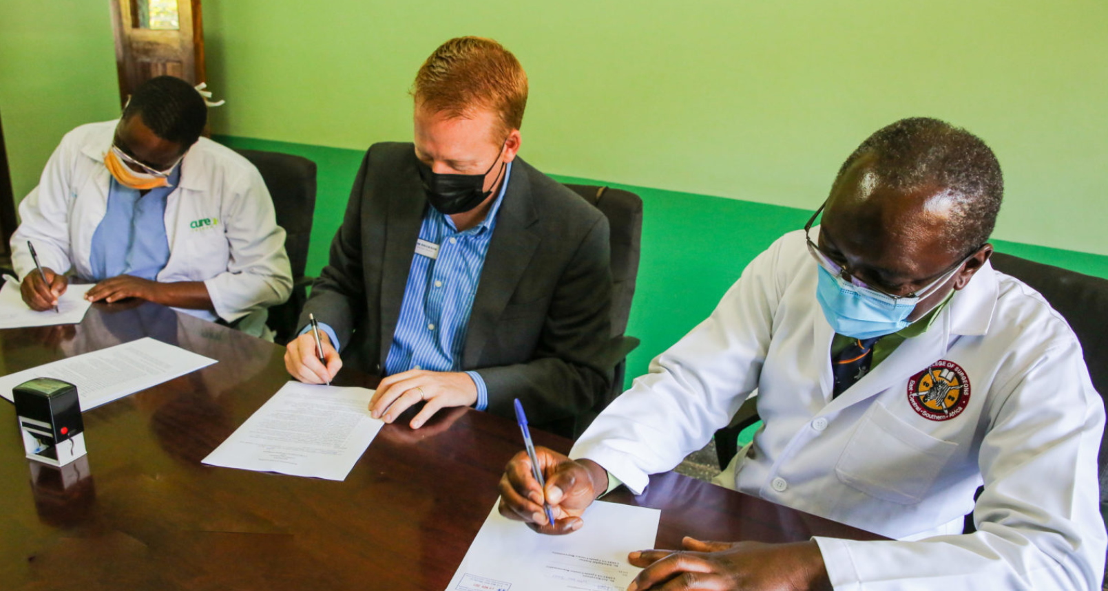
Expanding and Strengthening Strategic Partnerships and Collaborations
Increasing and Strengthening Research Capacity

Slide 50
Conclusion
Despite the challenges mentioned above, in this century, we have made steady but slow progress in :
1. Clinical services
2. Training
3. Research
There is still a serious problem of lack of Equity of service delivery
We need to work on increasing co-operation and collaborations

Slide 51
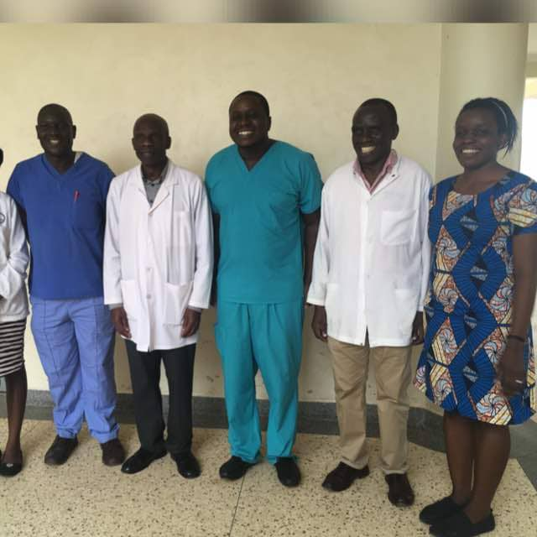
Words of wisdom
Agali awamu….........
Abakadde abagalana…….....
“Neurons that fire together, wire together”

Slide 52
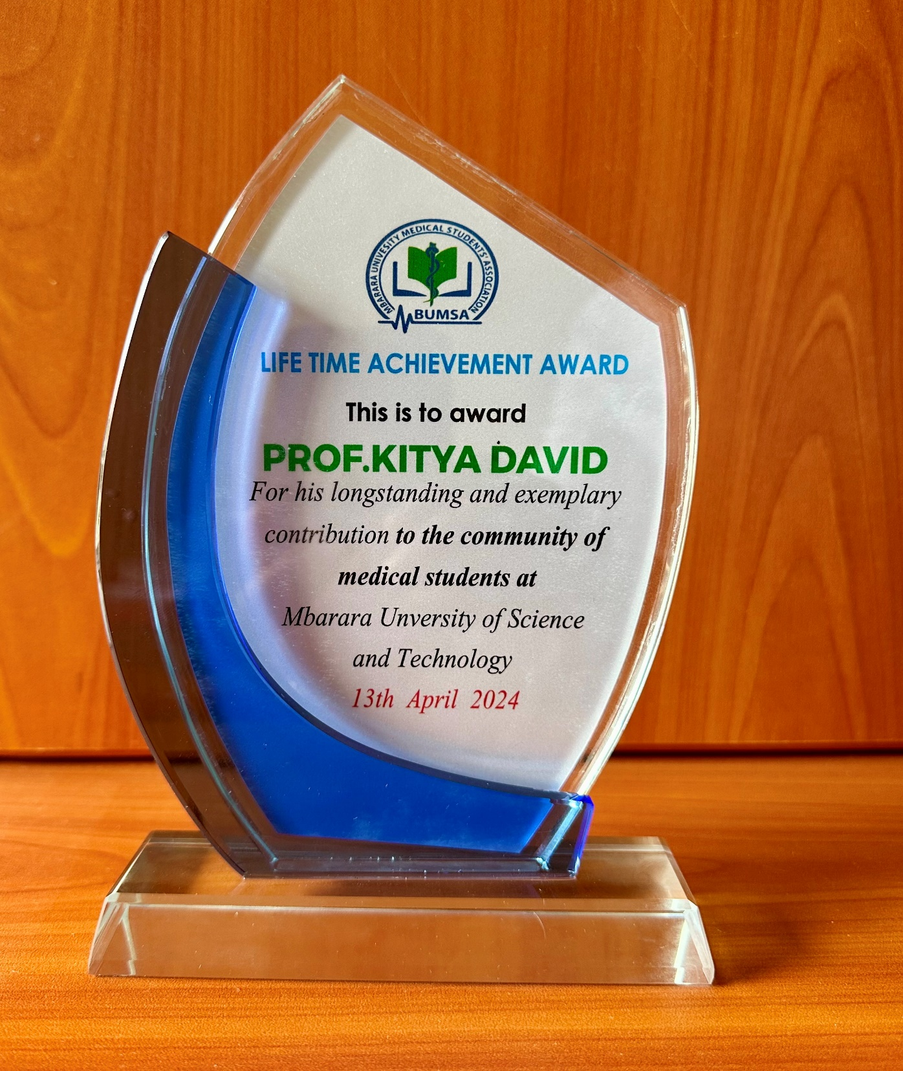
Word of reciprocal appreciation of MBUMSA
In 2017, Professor of the Year
In 2022, Hero

Slide 53
I hereby officially accept the appointment as Professor of Mbarara university of Science and Technology.
Professor David Kitya

Slide 54

Thank you

